Slide 1

Chapter 7
Transmission Media
7.<number>
Copyright © The McGraw-Hill Companies, Inc. Permission required for reproduction or display.

Slide 2

Figure 7.1 Transmission medium and physical layer
7.<number>

Slide 3

Figure 7.2 Classes of transmission media
7.<number>

Slide 4
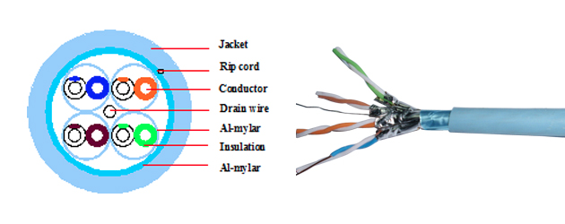

Physical media
bit: propagates between
transmitter/receiver pairs
physical link: what lies between transmitter & receiver
guided media:
  signals propagate in solid media: copper, fiber, coax
unguided media:
  signals propagate freely, e.g., radio
twisted pair (TP)
two insulated copper wires
  Category 5: 100 Mbps, 1 Gpbs Ethernet
  Category 6,7: 10Gbps
Notes:
one of the greatest advantages of CAT 7 cable is the shielding of its twisted pairs, which significantly improves noise resistance.
Drain Wire: The drain wire serves to complete an electrical circuit from the shield and carry unwanted electrical noise to ground away from the circuit.
Rip Cord: The purpose of a ripcord is to cut back the jacket to expose the wires of the cable so you don't run the risk of cutting any of the wires inside (you pull the cord, it cuts the jacket)

Slide 5

Figure 7.4 UTP and STP cables
7.<number>

Slide 6
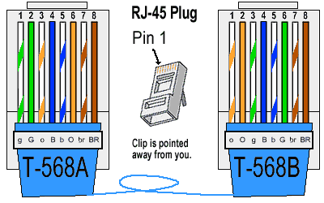
7.<number>

Slide 7


Physical media: coax, fiber
coaxial cable:
two concentric copper conductors
bidirectional
broadband:
  multiple channels on cable
  HFC (Hybrid Fiber Coaxial)
fiber optic cable:
glass fiber carrying light pulses, each pulse a bit
high-speed operation:
  high-speed point-to-point transmission (e.g., 10’s-100’s Gpbs transmission rate)
low error rate:
  repeaters spaced far apart
  immune to electromagnetic noise
Notes:
twisted pair cabling is better suited as compare to coax, when cost and installation are an issue and if EMI and crosstalk are not too much of a problem

Slide 8

Figure 7.7 Coaxial cable
7.<number>

Slide 9

Figure 7.8 BNC connectors
7.<number>
Notes:
Bayonet Neill–Concelman

Slide 10

Table 7.2 Categories of coaxial cables
7.<number>
Notes:
Electrical impedance is the measure of the opposition that a circuit presents to a current when a voltage is applied
10BASE2 (also known as cheapernet, thin Ethernet, thinnet, and thinwire) is a variant of Ethernet that uses thin coaxial cable (RG-58A/U or similar, as opposed to the thicker RG-8 cable used in 10BASE5 networks)

Slide 11

Figure 7.10 Bending of light ray
7.<number>

Slide 12

Figure 7.11 Optical fiber
7.<number>

Slide 13

Figure 7.12 Propagation modes
7.<number>

Slide 14

Figure 7.13 Modes
7.<number>

Slide 15

Figure 7.14 Fiber construction
7.<number>

Slide 16

Figure 7.15 Fiber-optic cable connectors
7.<number>

Slide 17
7-2 UNGUIDED MEDIA: WIRELESS
Unguided media transport electromagnetic waves without using a physical conductor. This type of communication is often referred to as wireless communication.
Topics discussed in this section:
Radio Waves
Microwaves
Infrared
7.<number>

Slide 18

Figure 7.17 Electromagnetic spectrum for wireless communication
7.<number>

Slide 19

Figure 7.19 Wireless transmission waves
7.<number>

Slide 20
signal carried in electromagnetic spectrum
no physical “wire”
bidirectional
propagation environment effects:
  reflection
  obstruction by objects
  interference
radio link types:
terrestrial microwave
  e.g. up to 45 Mbps channels
LAN (e.g., WiFi)
  11Mbps, 54 Mbps
wide-area (e.g., cellular)
  3G cellular: ~ few Mbps
satellite
  Kbps to 45Mbps channel (or multiple smaller channels)

Slide 21

Figure 7.20 Omnidirectional antenna
7.<number>

Slide 22

Note
Radio waves are used for multicast communications, such as radio and television, and paging systems.
7.<number>
Notes:
Paging System was used in Pagers, one way messaging system

Slide 23

Figure 7.21 Unidirectional antennas
7.<number>

Slide 24
Note
Microwaves are used for unicast communication such as cellular telephones, satellite networks,
and wireless LANs.
7.<number>

Slide 25
Note
Infrared signals can be used for short-range communication in a closed area using line-of-sight propagation.
7.<number>

